Slide 1
Find THAT Volume! (5.MD.C.5)

Slide 2
Find the volume of the prism below.
V = L x W x H
5 ft.
5ft.
5 ft.
Reminder: Volume is measured in cubic units

Slide 3
And the answer is…
125 cubic feet or
125 ft³

Slide 4
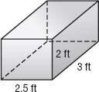
Find the volume of the prism below.

Slide 5
And the answer is….
15 cubic feet or
15 ft³

Slide 6
Find the volume of the prism below.
12.3 ft.
2.4 ft.
5ft

Slide 7
And the answer is…
147.6 cubic feet or
147.6 ft³

Slide 8
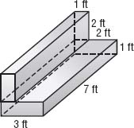
Find the volume of the composite figure below.
Reminder: Find the volume of each rectangular prism, then add them together.

Slide 9
And the answer is…
35 cubic feet or
35 ft³

Slide 10
Find the volume of the composite figure below.
4 in
5 in
10 in
9 in
8 in

Slide 11
And the answer is…
880 cubic inches or 880 in³

Slide 12
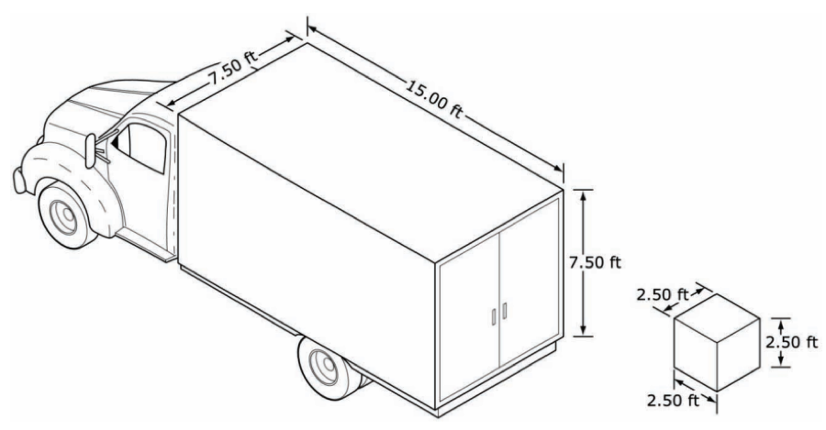
Find the volume of the truck. Find the volume of the box.

Slide 13
And the answer is…
Truck: 843.75 cubic feet
Box: 15.625 cubic feet

Slide 14
Find the volume of the prism below.
20 m
6 m
12 m
5 m
24 m

Slide 15
And the answer is…
2,040 cubic meters or 2,040 m³

Slide 16
Find the volume of the prism below.
10.2 ft
5 ft
12.3 ft
4 ft
5.5 ft

Slide 17
And the answer is…
364.6 cubic ft or 364.6 ft³

Slide 18
Find the volume of the prism below.
8 in.
9 in.
15 in.
6 in.
7 in.
11 in.

Slide 19
And the answer is…
966 cubic inches or 966 in³

Slide 20
Find the volume of the prism below.
20 cm
5 cm
15 cm
10 cm
2 cm 7 cm

Slide 21
And the answer is…
340 cubic cm or 340 cm³

Slide 22
Credits
Visit my store for more great products!
https://www.teacherspayteachers.com/Store/Abseas

